Slide 1
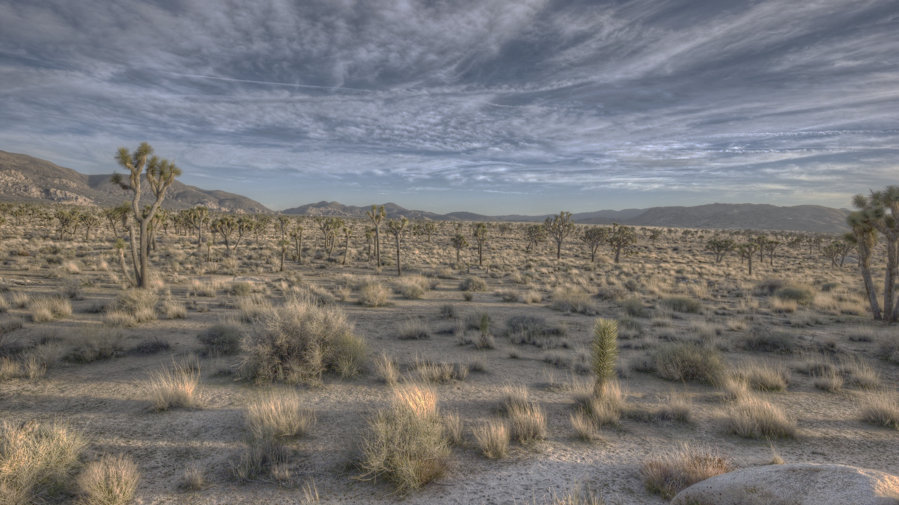
A contrast of micro and macroclimatic effects on vertebrate interactions with foundational plant species.
Nargol Ghazian
Supervisor: Dr. Chris Lortie
Advisor: Dr. Suzanne MacDonald
Thesis Proposal

Slide 2
Background
One interacting species benefits, none are harmed (Bertness and Leonard 1997)
Can be commensalism or mutualistic
Foundational plants are usually shrubs, perennials, trees or cushion plants
Benefit other taxa through a variety of mechanistic pathways
Canopy is important for direct and indirect shelter and refuge effects and nutrient gathering

Slide 3
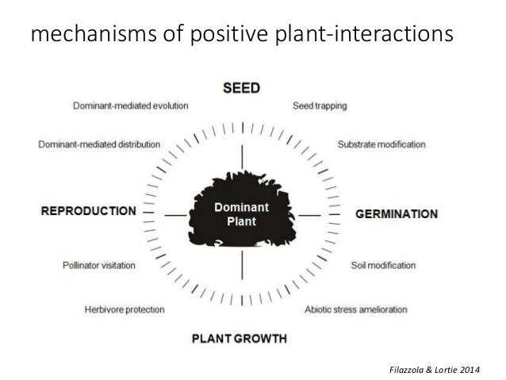

Slide 4
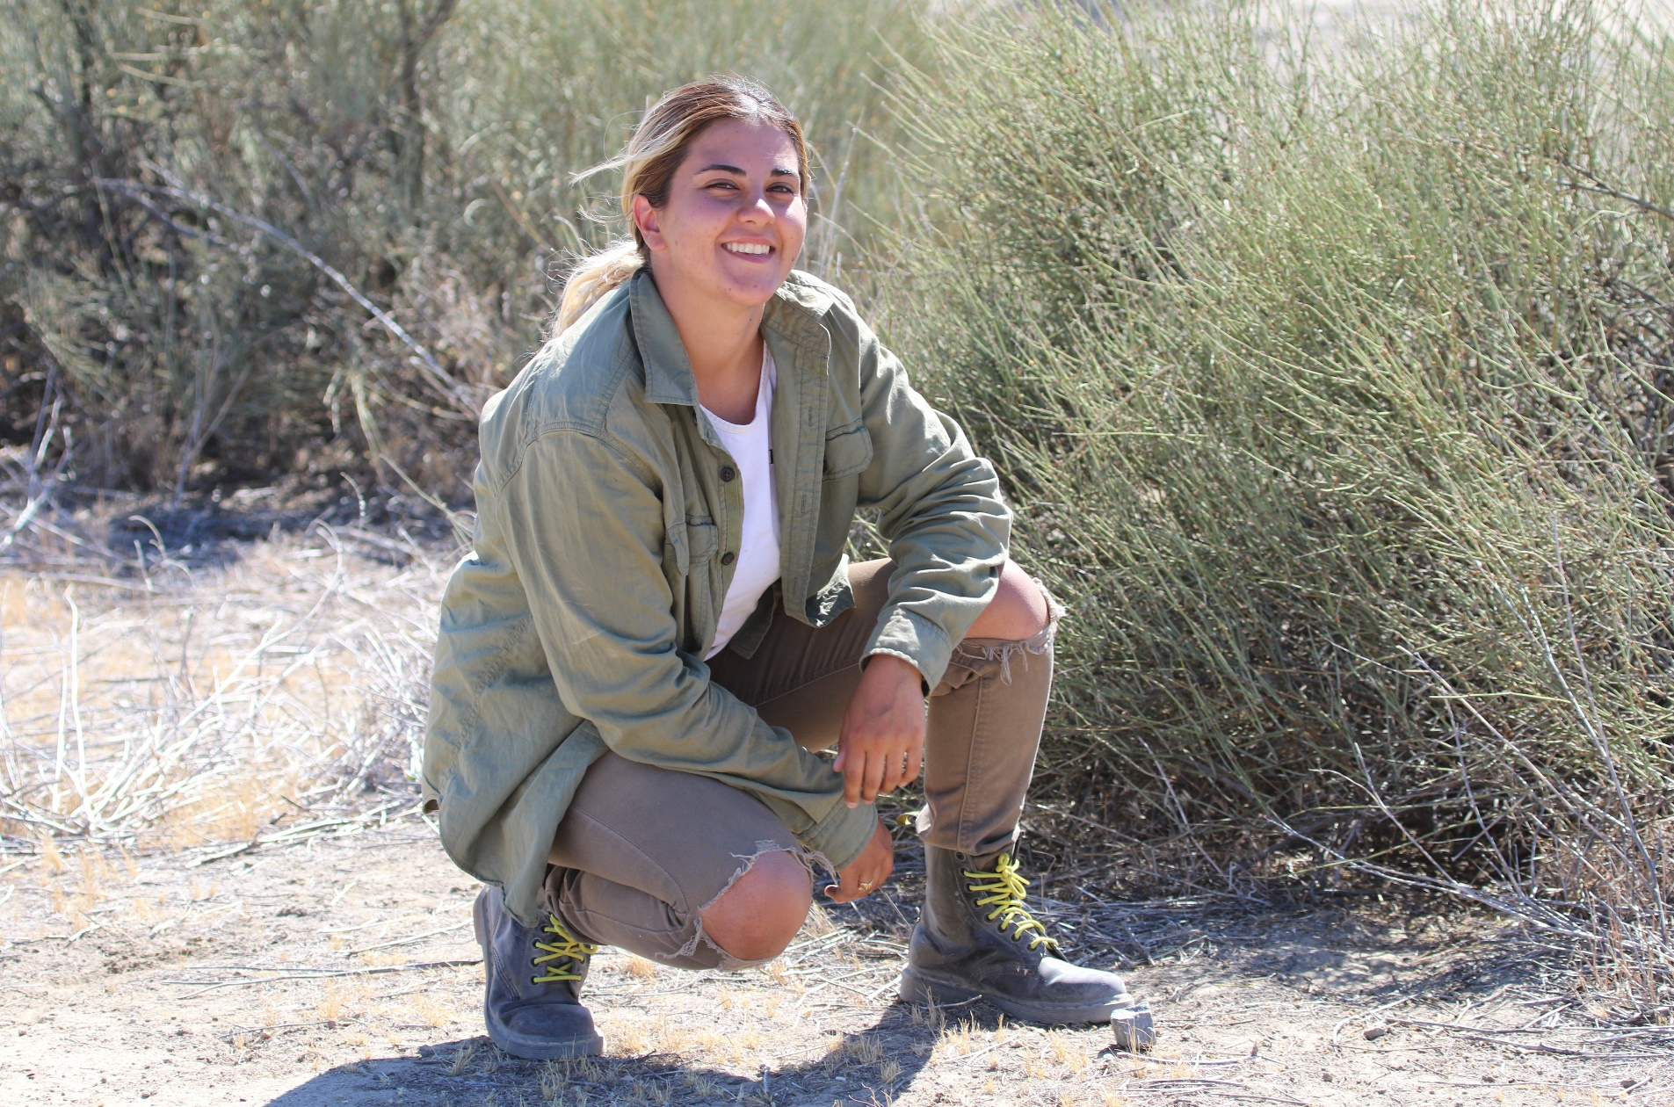
Background: Epherdra californica
(Not Ephedra, just me)

Slide 5
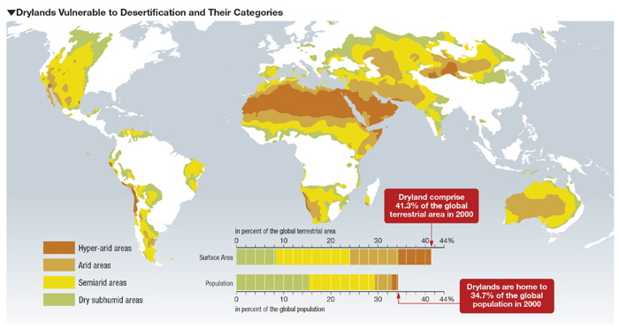
Background
(Google Images)

Slide 6
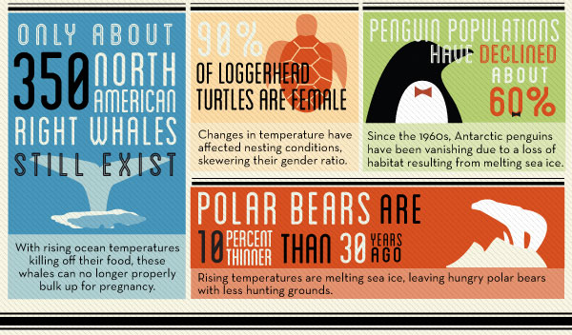
Background
(National Geographic)

Slide 7
Background
Weather: short term changes in atmospheric conditions of an area
Climate: long-term weather patterns of a particular region
Weather=micro-climate
Climate=macro-climate

Slide 8




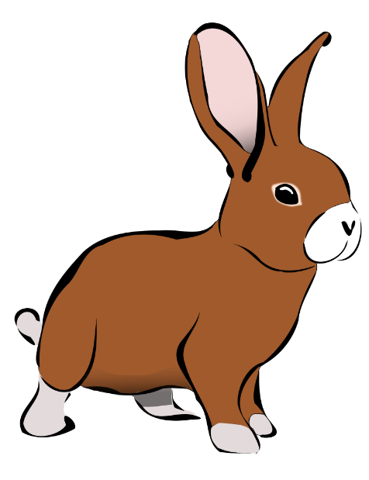


Slide 9
Timeline Goals
Chapter | Methods | Timeline
1. A systematic review of camera trap papers to test for reported sampling effort. | Extract data for number of pictures taken, number of species seen, and location from peer-reviewed primary literature. | Analyse data in January 2019 and have the manuscript by end of April 2019
2. Plant-animal interactions at an on-site level. | Camera trap and video trap data against long-term climate data. | -Match imagery data to micro-climate April 2018 -Do stats May 2019 - Have a manuscript ready by Sep. 2019
3. Shelter effects on vertebrate animal interactions with foundation plant species. | -Manipulate temperature, radiation, and moisture by building shelters -Measure growth of plants, take soils samples before and after -camera trap set at a few | -Have a manuscript ready by January 2020 -Wrap-up thesis by September 2020

Slide 10
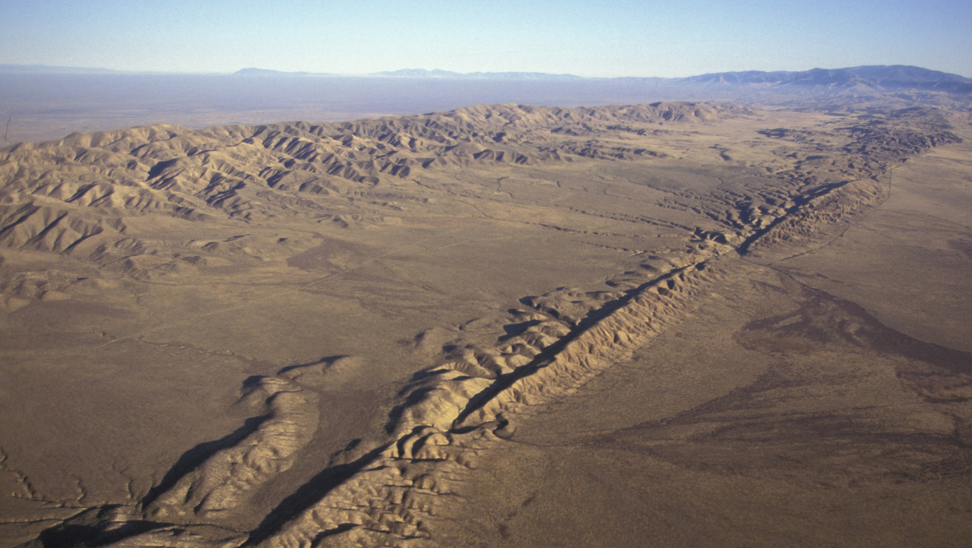
Location: Carrizo Plain National Monument sites 3 & 4

Slide 11
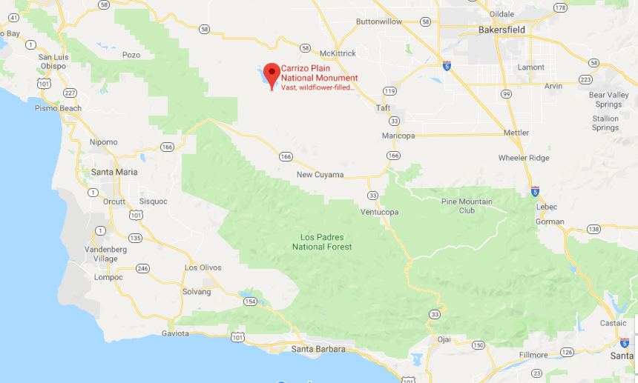
Location: Carrizo Plain National Monument
San Luis Obispo Country, California
(35.1914° N, 119.7929° W)
(Google Maps)

Slide 12
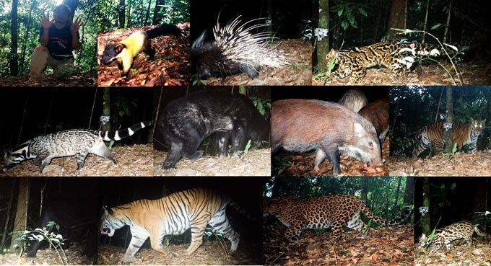
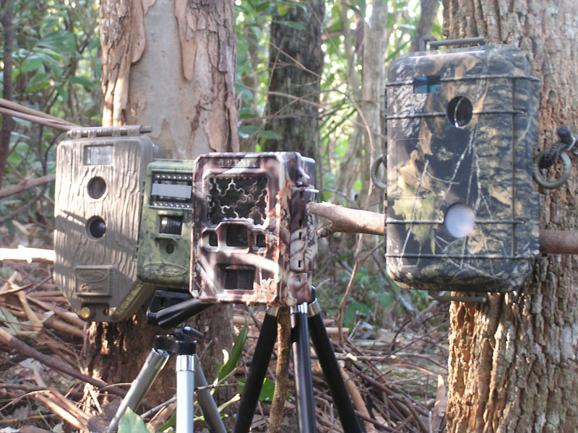
Chapter 1: A systematic review of camera trap papers to test for reported sampling effort.
(Google Images)

Slide 13
Chapter 1: A systematic review of camera trap papers to test for reported sampling effort.
Purpose:
Identify the relevant literature using camera traps to examine sampling efficacy for abundance and richness of animals with this trapping tool
Questions:
In which ecosystems was camera trapping done?
What was the duration of sampling?
How many pictures were taken? How many had animals in them?
What were the animals (species)?
How many species in reality settle in that habitat (GBIF)?
What was the sampling area? Was the total area sampled reported?
Was the camera field of view reported?

Slide 14
Chapter 1: A systematic review of camera trap papers to test for reported sampling effort.
Predictions:
Many studies using camera traps focus on one type of species
Makes it difficult to record species richness of a given area
Most studies will solely report either the duration of camera trapping or the number of photos
Rarely focus on minimizing repeat visits

Slide 15
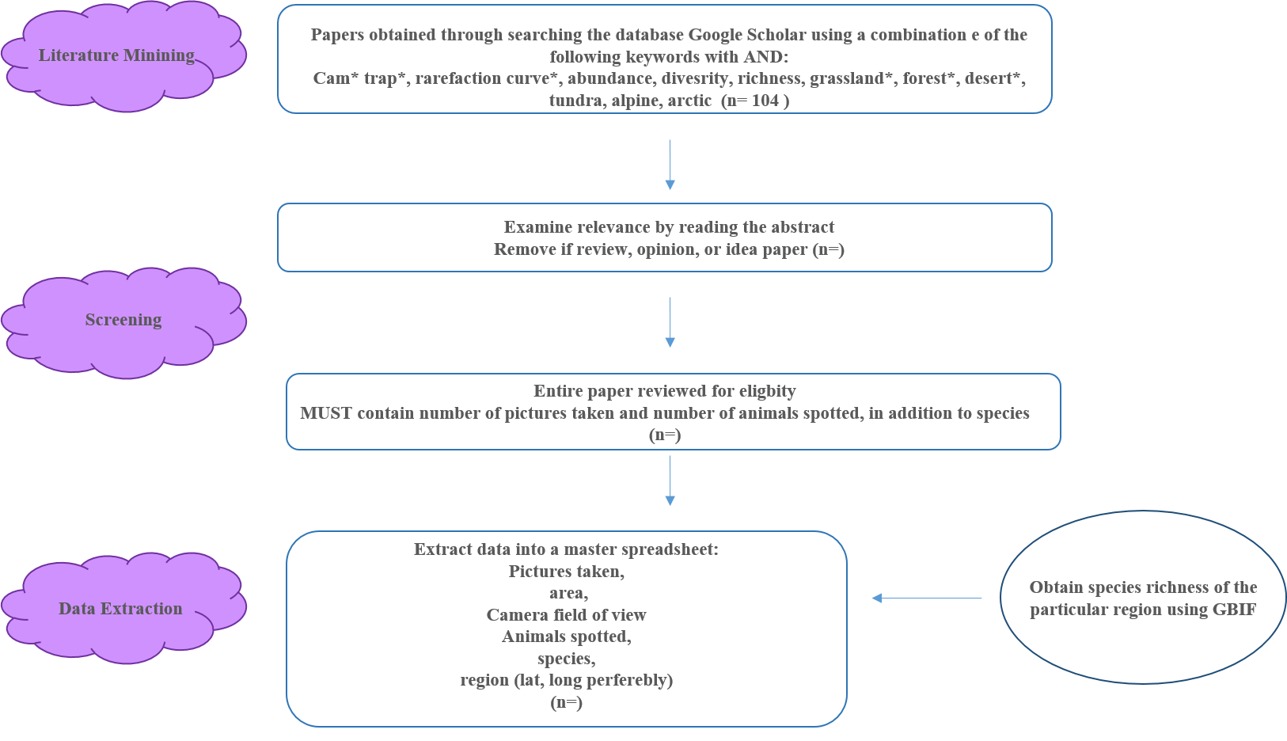

Slide 16
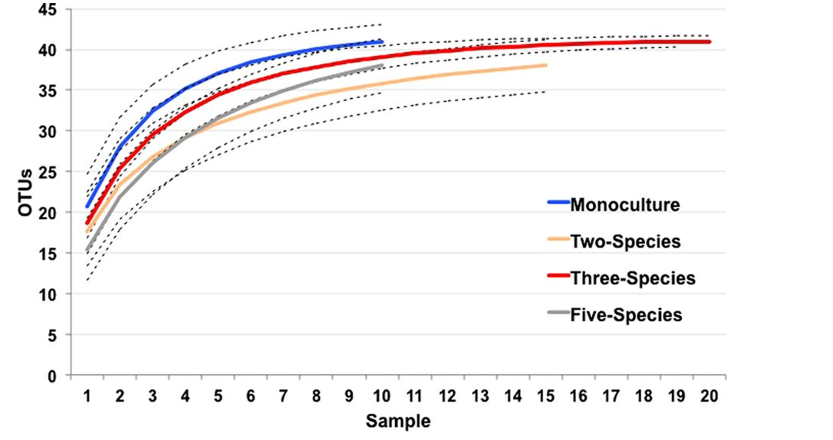
(Nguyen etl al. 2017)

Slide 17
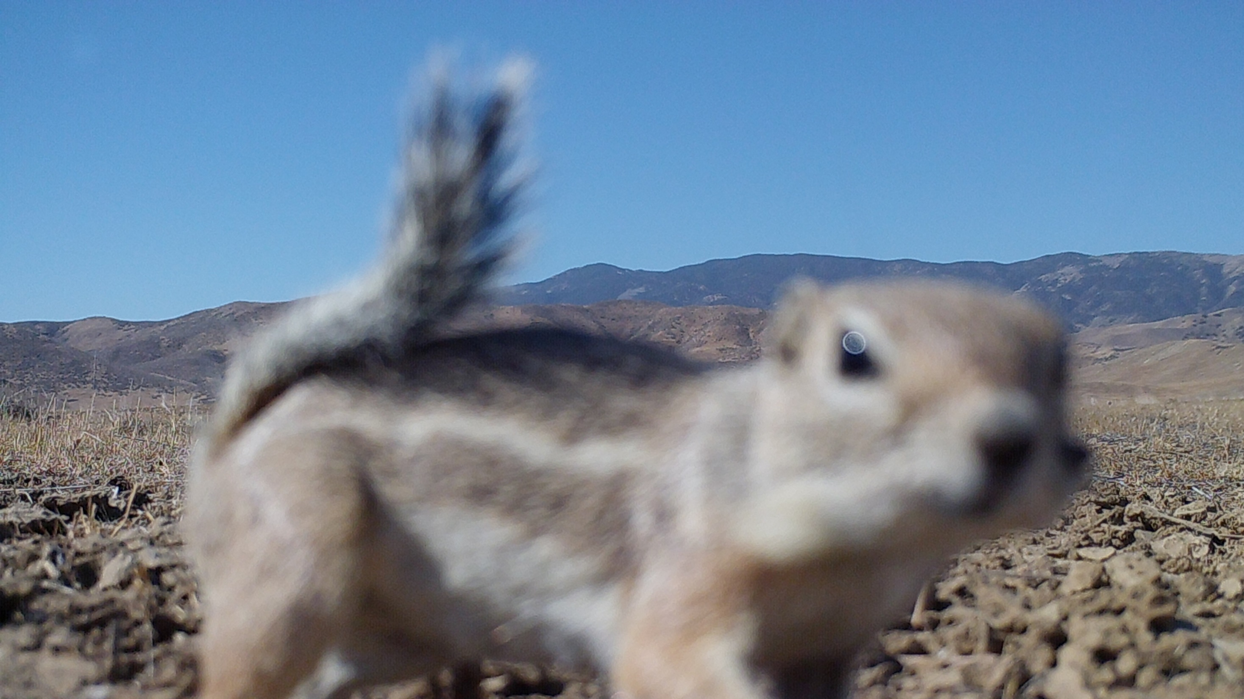
Chapter 2: Plant-animal interactions at an on-site level.

Slide 18
Chapter 2: Plant-animal interactions at an on-site level.
Purpose: To explore whether animal association patterns with shrubs are explained by site-level daily weather data.
Questions:
How do temperature, precipitation, solar radiation, and humidity influence the associational patterns of vertebrates with shrubs?
How does the strength of this association change as the above parameters increase or decrease?

Slide 19
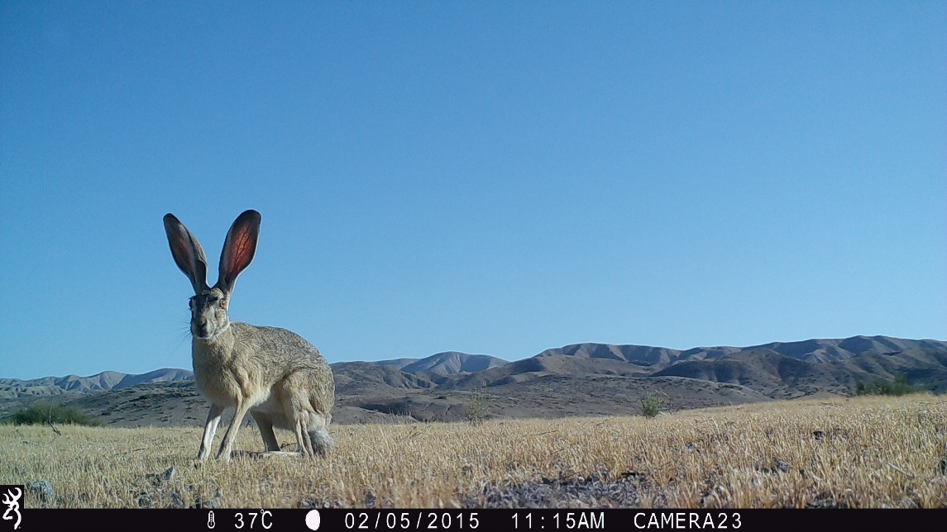
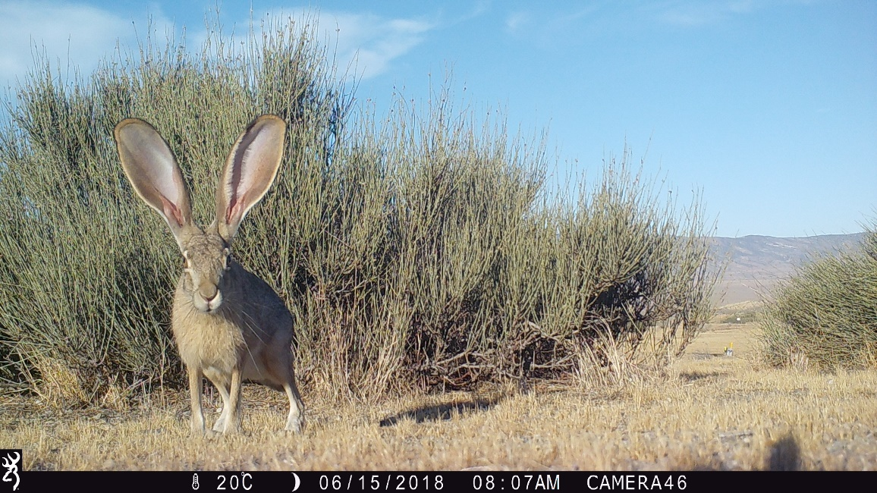
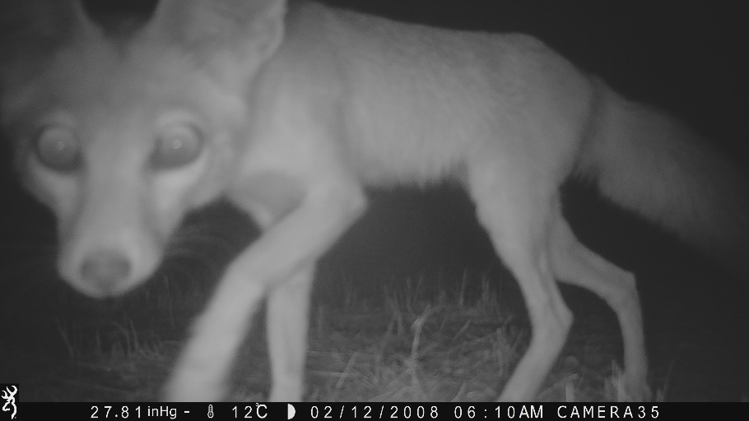
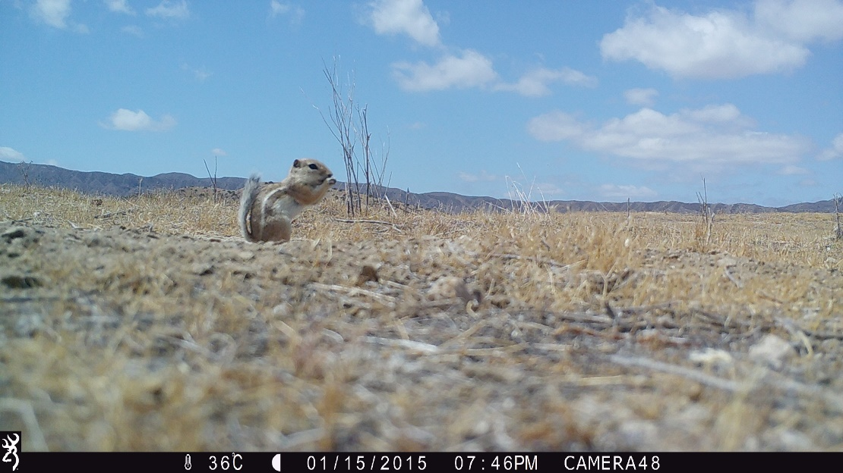

Slide 20
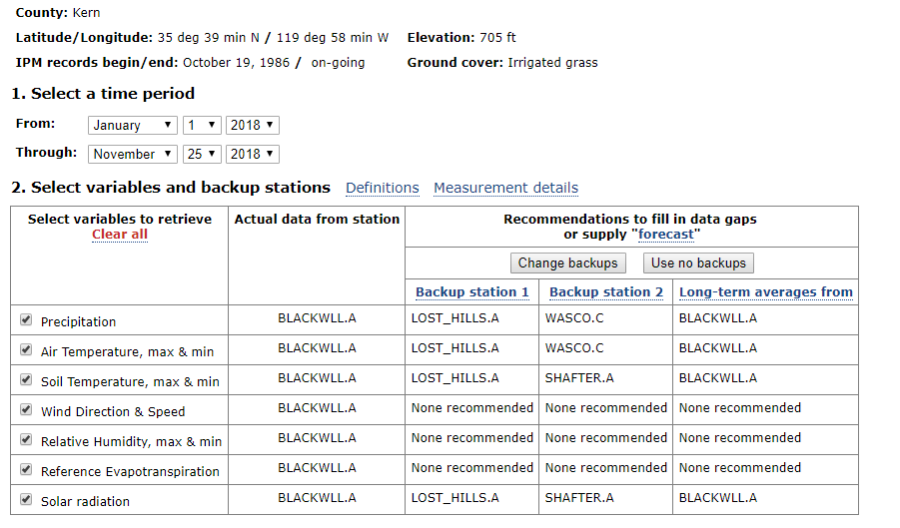
(University of California Agriculture and Natural Resources)

Slide 21
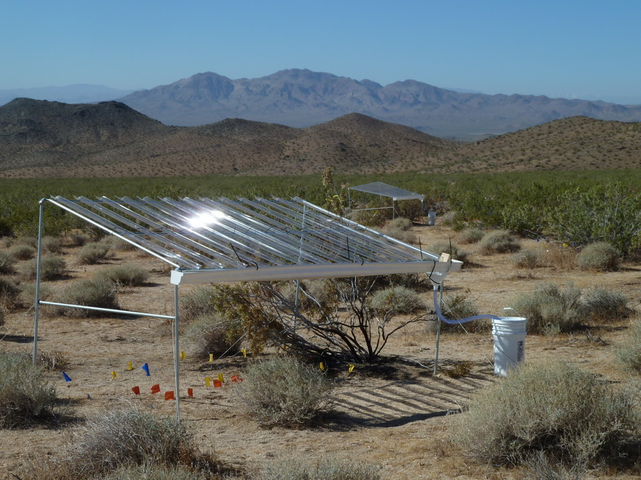
Chapter 3: shelter experiment to manipulate micro-climatic conditions.

Slide 22
Chapter 3: shelter experiment to manipulate micro-climatic conditions.
Purpose: To physically manipulate temperature, solar radiation intensity, and moisture using UV permeable Perspex to examine how the increase/decrease in in the above parameters affects animal-plant shrub associational parents.
Hypotheses and predictions:
Foundation species, shelter, and relatively large objects in desert ecosystems influence association behaviour and population dynamics including movement.
The presence of a foundational species will likely increase the soil microbiota due to the benefits provided by the plant (Bodelier et al. 2006).

Slide 23
Replication Breakdown
Microsite | Shelter | Replication | Total
2 | 3 | X 8: X4 in site 3 X4 in site 4 | 48
Shrub | Light completely blocked
Open | Temperature/moisture
 | Mesh shelter (control)

Slide 24
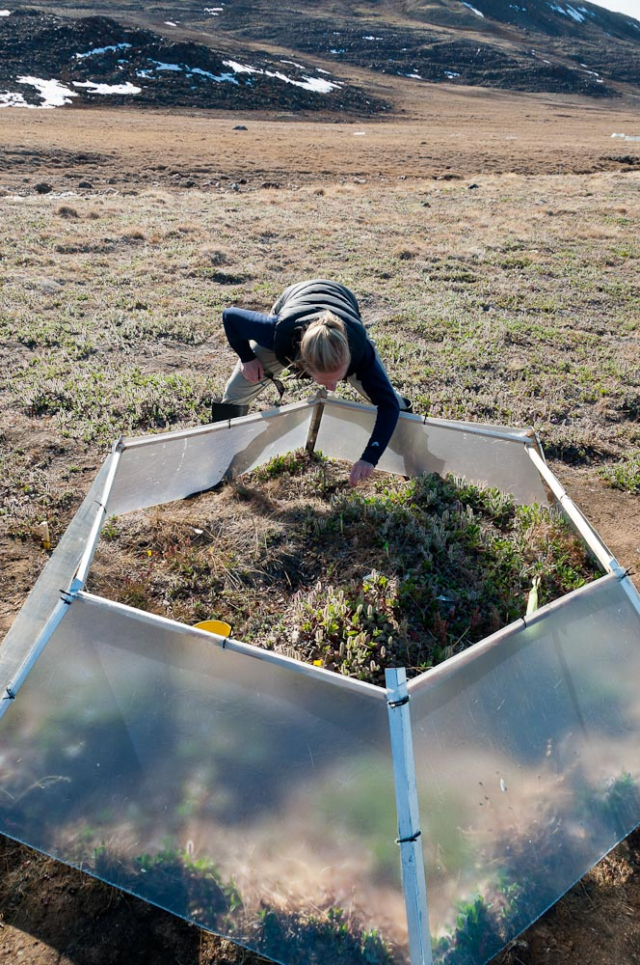
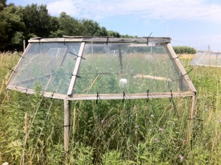
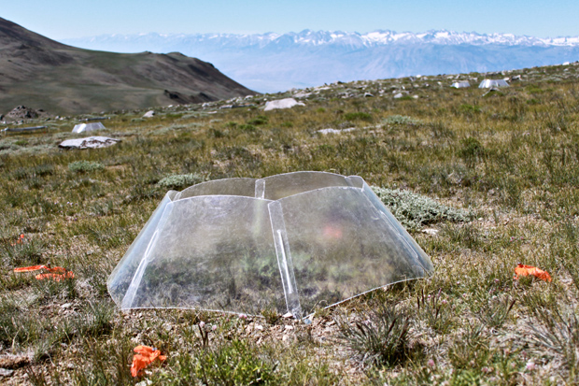
(Google Images)

Slide 25



UV permeable Perspex vs. Open-Top-Chamber
Variable | Perspex Shelter | OTC
Shelter
Temperature/Soil Temp.
UV
Movement
Wind
Humidity
Radiance
Resources
Substrate
Moisture

Slide 26
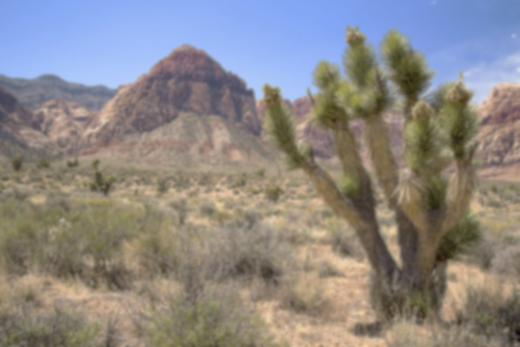
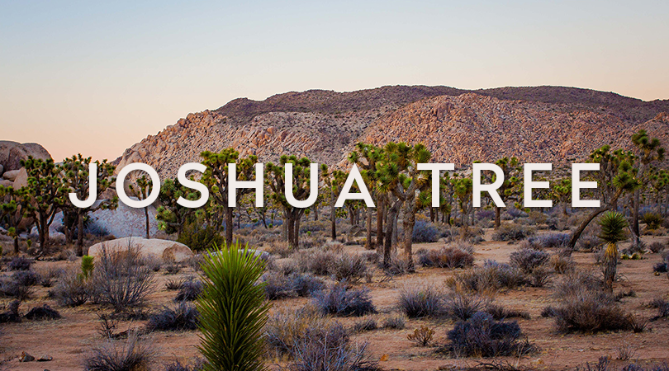

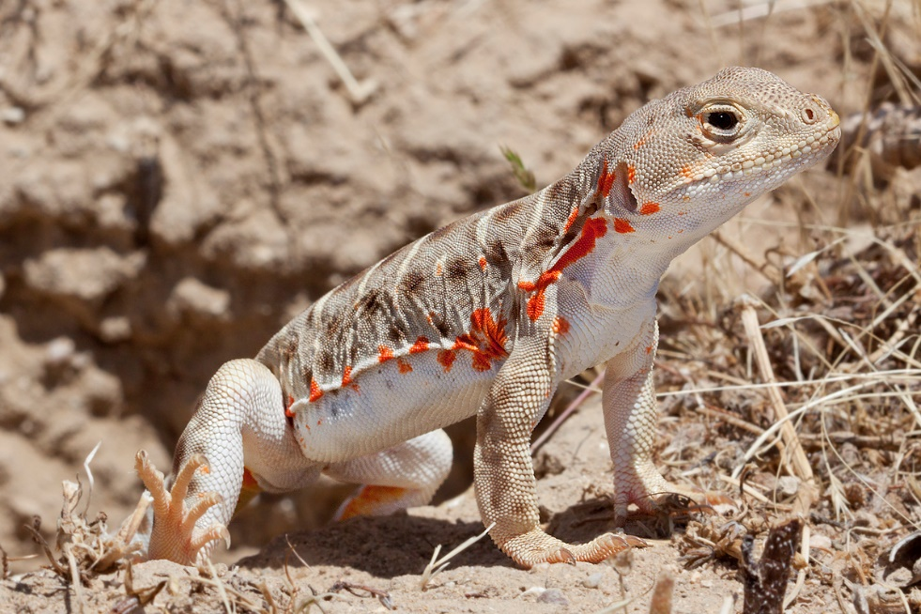
Implications

Slide 27



Thank You!
Dr. Chris Lortie
Dr. Suzanne MacDonald
Malory Owen
Mario Zuliani
Ecoblender

Slide 29
Back-up
7 different sites
San Joaquin, Mojave, Carrizo, Cuyama, Penoche
7 different temperature gradients
Cam trap and video trap at all

Slide 30
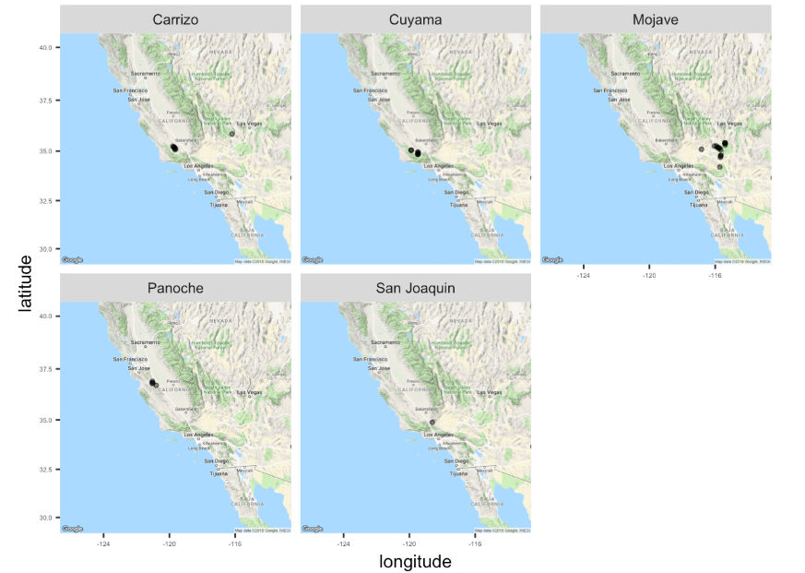
(Lortie, Github)

